Slide 1


Slide 2
Asymptotic Analysis of Sorting Algorithms
Comparative Study of Merge Sort and Quick Sort
Course Code: CSA0606
Course Name: Design and Analysis of Algorithms
Presented by :
Adhiti. S
192411069

Slide 3
INTRODUCTION
Sorting algorithms arrange data in ascending or descending order to enable faster processing and searching.
Merge Sort and Quick Sort are efficient divide-and-conquer algorithms widely used for handling large datasets.
Asymptotic analysis evaluates an algorithm's efficiency by measuring its time complexity as the input size increases.

Slide 4
PROBLEM STATEMENT
Large datasets require efficient sorting for faster processing and better system performance.
Different sorting algorithms perform differently depending on the input size and data arrangement.
How can we compare Merge Sort and Quick Sort using asymptotic analysis to identify the most efficient algorithm for different scenarios?

Slide 5
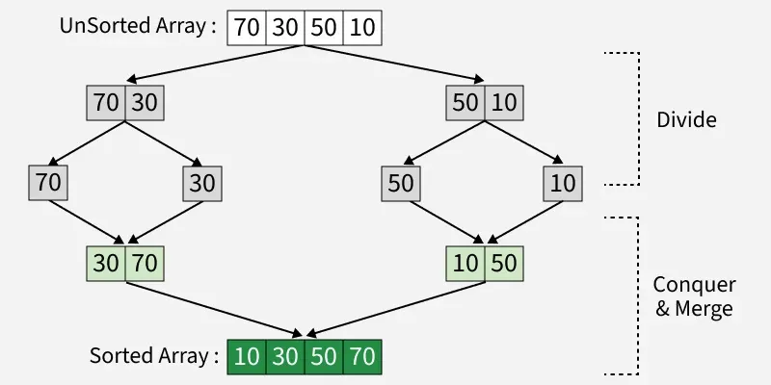
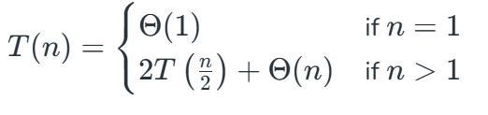
MERGE SORT
Divide: Divide the list or array recursively into two halves until it can no more be divided.
Conquer: Each subarray is sorted individually using the merge sort algorithm.
Merge: The sorted subarrays are merged back together in sorted order.

Slide 6
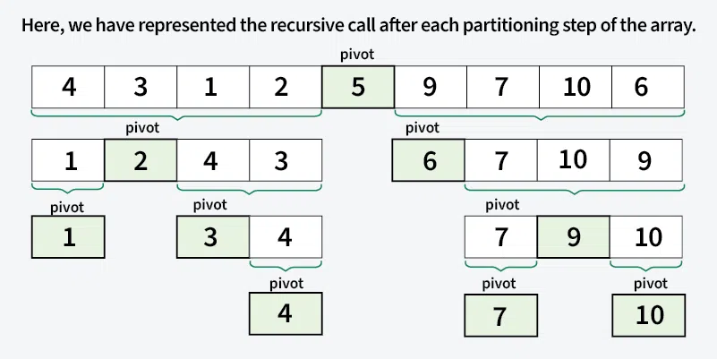
QUICK SORT
Choose a Pivot: Select an element from the array as the pivot.
Partition the Array: After partitioning, all elements smaller than the pivot will be on its left, and all elements greater than the pivot will be on its right.
Recursively Call: Recursively apply the same process to the two partitioned sub-arrays.

Slide 7
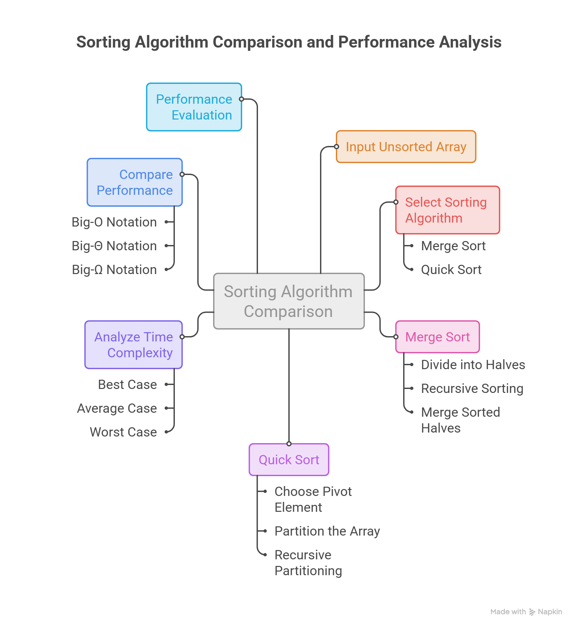
SYSTEM ARCHITECTURE

Slide 8
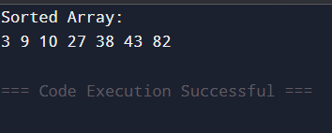
MERGE SORT - IMPLEMENTATION
void mergeSort(int arr[], int left, int right)
{
if(left < right)
{
int mid = (left + right) / 2;
mergeSort(arr, left, mid);
mergeSort(arr, mid + 1, right);
merge(arr, left, mid, right);
}
}
while(i < n1 && j < n2)
{
if(L[i] <= R[j])
arr[k++] = L[i++];
else
arr[k++] = R[j++];
}

Slide 9
QUICK SORT - IMPLEMENTATION
void quickSort(int arr[], int low, int high)
{
if(low < high)
{
int pivotIndex = partition(arr, low, high);
quickSort(arr, low, pivotIndex - 1);
quickSort(arr, pivotIndex + 1, high);
}
}
void quickSort(int arr[], int low, int high)
{
if(low < high)
{
int pivotIndex = partition(arr, low, high);
quickSort(arr, low, pivotIndex - 1);
quickSort(arr, pivotIndex + 1, high);
}
}

Slide 10
COMPLEXITY ANALYSIS
Case | Merge Sort | Quick Sort | Explanation
Best Case | O(n log n) | O(n log n) | Array is divided into balanced partitions, requiring log n levels with n operations at each level.
Average Case | O(n log n) | O(n log n) | Both algorithms generally perform efficiently for random input data.
Worst Case | O(n log n) | O(n²) | Merge Sort remains consistent, while Quick Sort degrades when the pivot produces highly unbalanced partitions.
Space Complexity | O(n) | O(log n) | Merge Sort requires additional memory for merging, whereas Quick Sort mainly uses recursion stack space.
Stability | Stable | Not Stable | Merge Sort preserves the order of equal elements; Quick Sort may change it.

Slide 11
MERGE SORT Vs QUICK SORT
Parameter | Merge Sort | Quick Sort | More Efficient
Sorting Strategy | Divide and Merge | Partition around Pivot | Quick Sort (simpler operations)
Execution Speed (Average) | Good | Very Fast | Quick Sort
Execution Speed (Worst Case) | Consistent | Slower due to poor pivot | Merge Sort
Memory Usage | High (Extra Array) | Low (In-place) | Quick Sort
Stability | Stable | Not Stable | Merge Sort
Cache Performance | Moderate | Excellent | Quick Sort
Scalability | Highly Scalable | Highly Scalable (Average Case) | Tie
Reliability | Predictable Performance | Depends on Pivot Selection | Merge Sort
Suitable for Linked Lists | Excellent | Not Preferred | Merge Sort
Suitable for Arrays | Good | Excellent | Quick Sort
Real-World Applications | External Sorting, Databases | Programming Libraries, System Software | Depends on Use Case

Slide 12
CONCLUSION
Quick Sort → real-world applications because of its excellent average-case performance (O(n log n)), low memory usage (O(log n)), and better cache efficiency, making it faster in practice.
Merge Sort → stable sorting, guaranteed O(n log n) performance, or linked-list sorting is required, since its performance remains consistent even in the worst case.
Therefore, for general-purpose array sorting - Quick Sort
applications that demand predictable and stable performance – Merge Sort.

Slide 13
REFERENCES
GeeksforGeeks. Merge Sort Algorithm. Available at: https://www.geeksforgeeks.org/merge-sort/ (Accessed: July 2026).
GeeksforGeeks. Quick Sort Algorithm. Available at: https://www.geeksforgeeks.org/quick-sort-algorithm/ (Accessed: July 2026).
GeeksforGeeks. Analysis of Algorithms – Asymptotic Notations. Available at: https://www.geeksforgeeks.org/analysis-of-algorithms-set-3asymptotic-notations/ (Accessed: July 2026).
Cormen, T. H., Leiserson, C. E., Rivest, R. L., & Stein, C. Introduction to Algorithms (4th Edition). MIT Press.

Slide 14
THANK YOU

